Slide 1






Chapter 3: PURCHASE MANAGEMENT IN ERP

Slide 2
TEAM 08
01
1
Nguyễn Trần Chí Đức - 20521199
2
Nguyễn Xuân Thịnh - 20521967

Slide 3






CHAPTER’S MAIN CONTENTS
02
1
Some basic concepts of purchasing
2
Master Data in ERP – Purchase
3
Purchasing process
Correlation between Purchasing and Selling
4

Slide 4
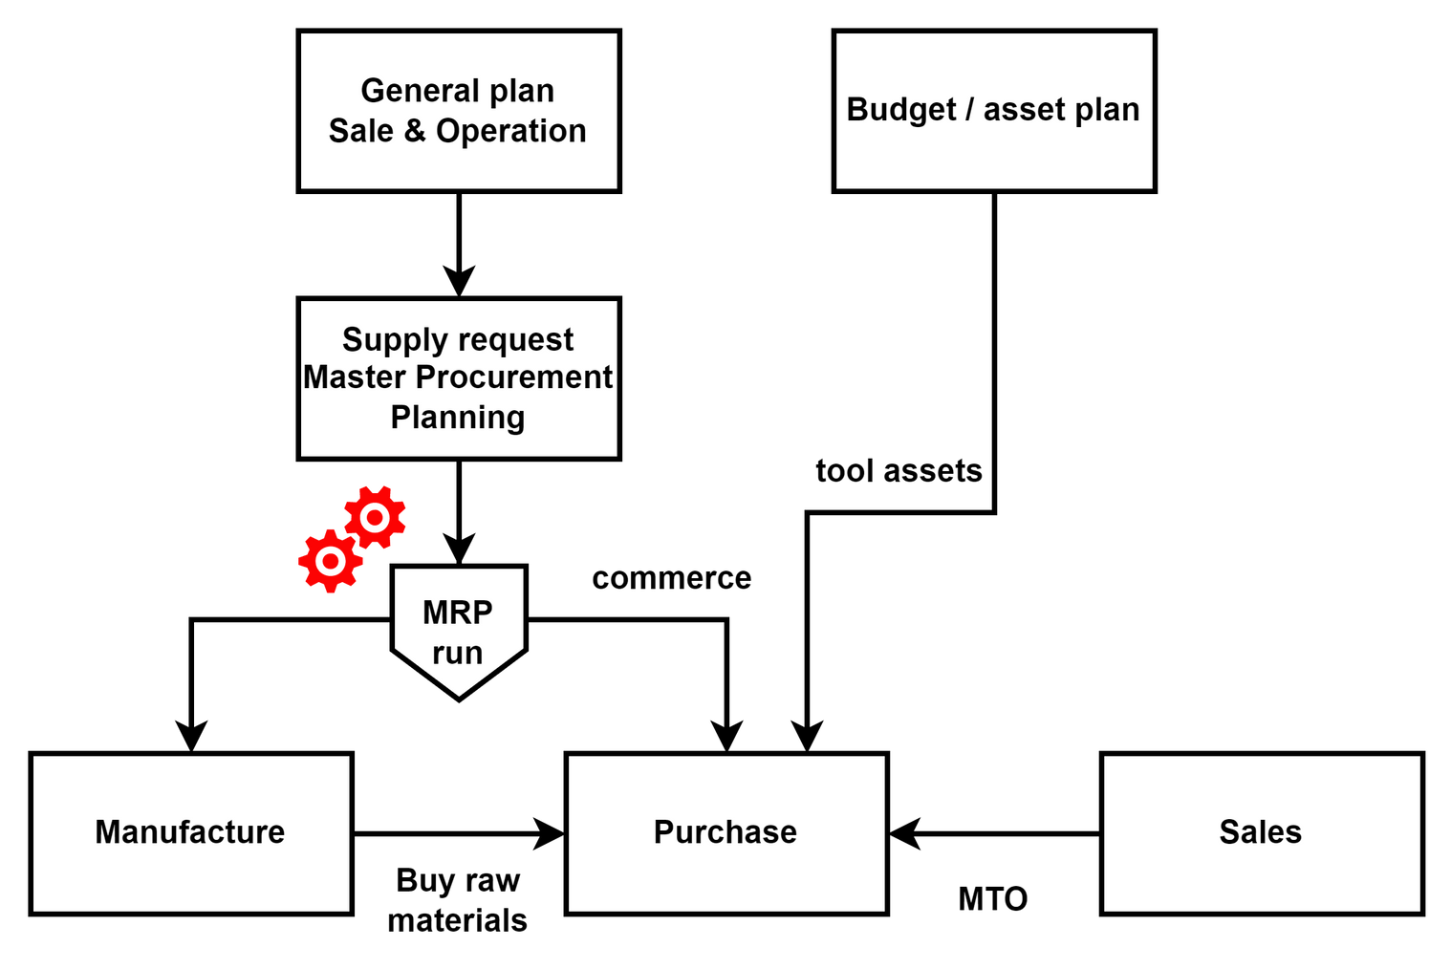
1. Some basic concepts of purchasing
03
The origin of purchasing activities is to serve manufacture, sales, commercial storage, purchase of assets and tools.

Slide 5
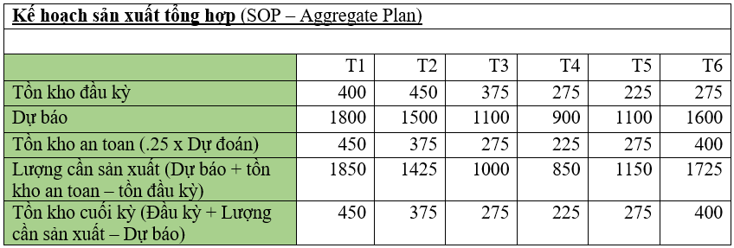
1. Some basic concepts of purchasing
04
a. Purchasing to serve manufacture: Start from Aggregate Plan (SOP – Sale & Operation Planning), this is a business model in the direction of MTS (Make To Stock) with production base on SOP(Standard Operating Procedures) to stockpile before selling.
b. Purchase to stock up on commercial goods: for commercial businesses (not manufacturing, only buying and selling). The SOP (at the Sales Planning section) will be converted into a commercial product purchase order for sale on a periodic basis.

Slide 6
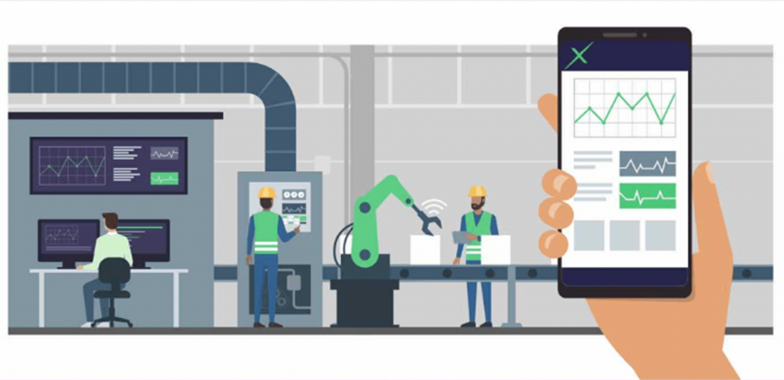
1. Some basic concepts of purchasing
05
c. Purchasing for Sales: This is an MTO (Make To Order) oriented business, the product will not be created or stocked in advance, but only appears when there is a customer's temptation to buy.

Slide 7

1. Some basic concepts of purchasing
06
d. Purchasing property and tools: Buying assets, tools: based on the annual allocated budget, the company will make a decision to purchase assets (factories, vehicles, ...) or tools.

Slide 8
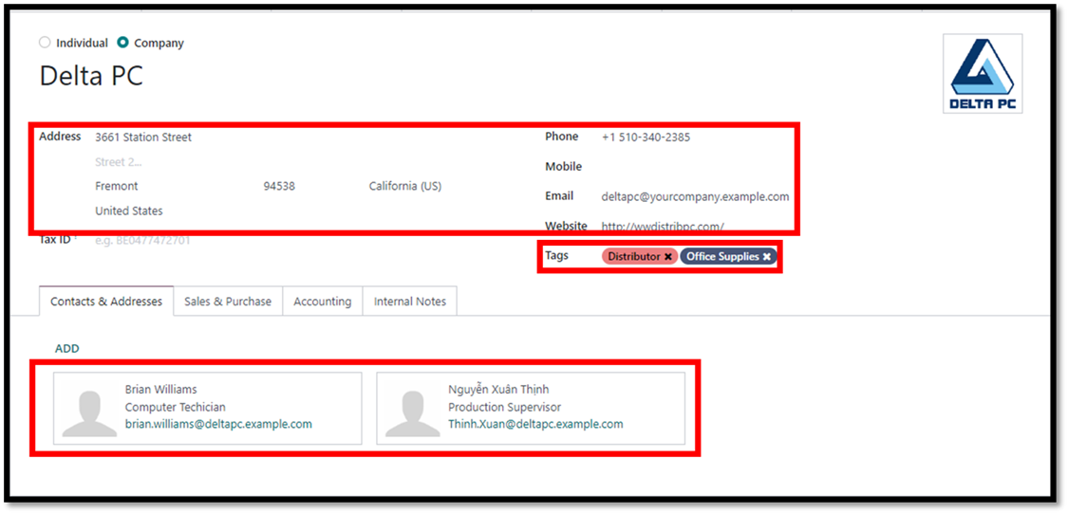
2. Master Data in ERP – Purchase
2.1 Vendor Master Data
07
Like customer master data, supplier master data still have 3 kind of information should be stored include:
• General information:

Slide 9
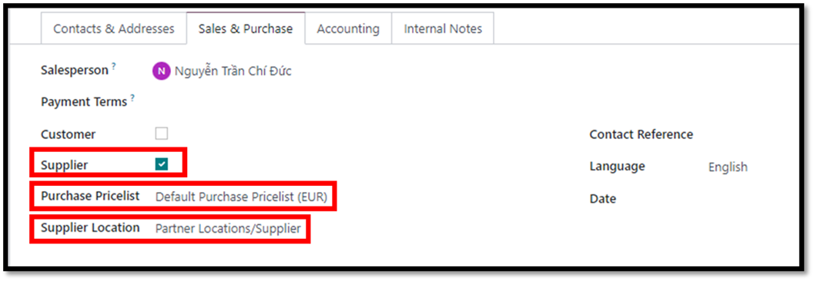
2. Master Data in ERP – Purchase
2.1 Vendor Master Data
08
• Purchase information:

Slide 10
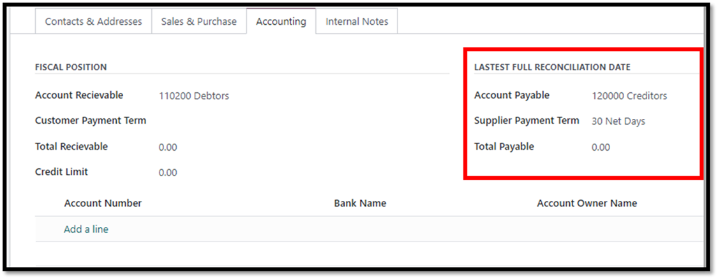
2. Master Data in ERP – Purchase
2.1 Vendor Master Data
09
• Accounting information:

Slide 11
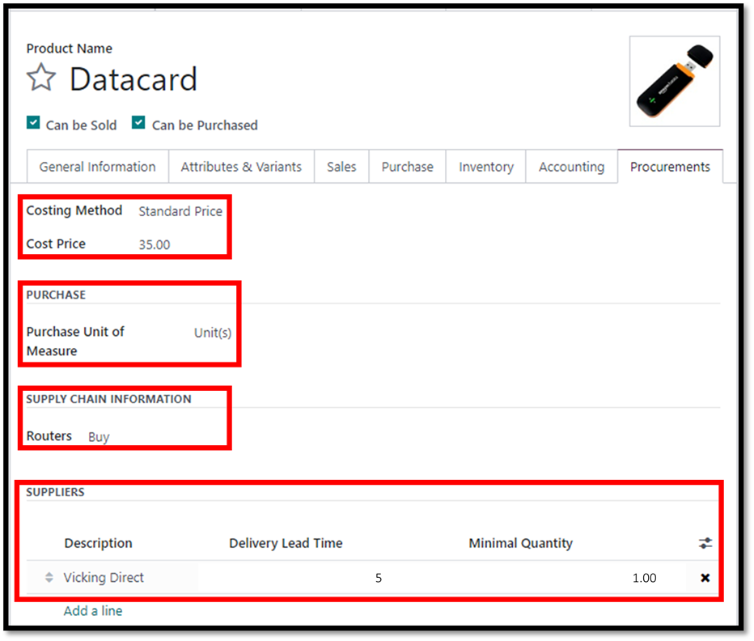
2. Master Data in ERP – Purchase
2.2. Material Master Data
10

Slide 12
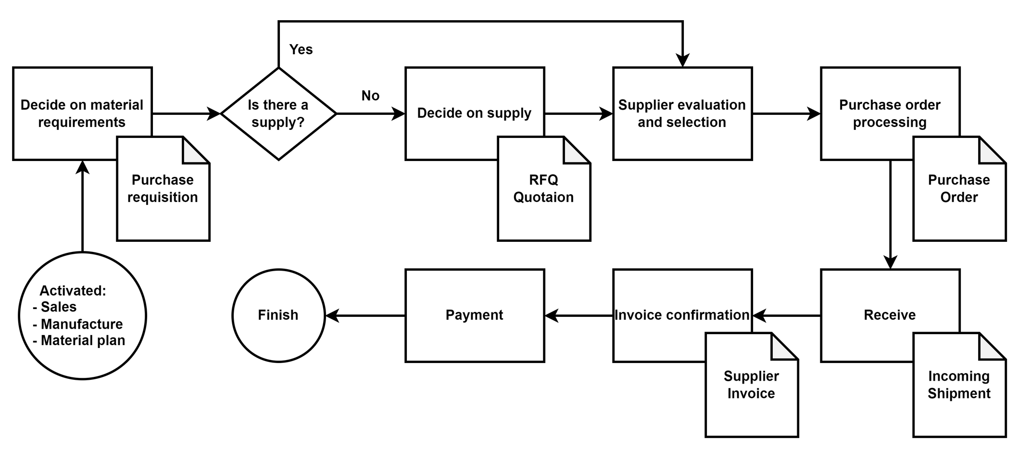
3. Purchasing process
General Process:
11
As shown in Figure 3 8, purchasing is triggered by other processes such as production, material planning, or sales.

Slide 13
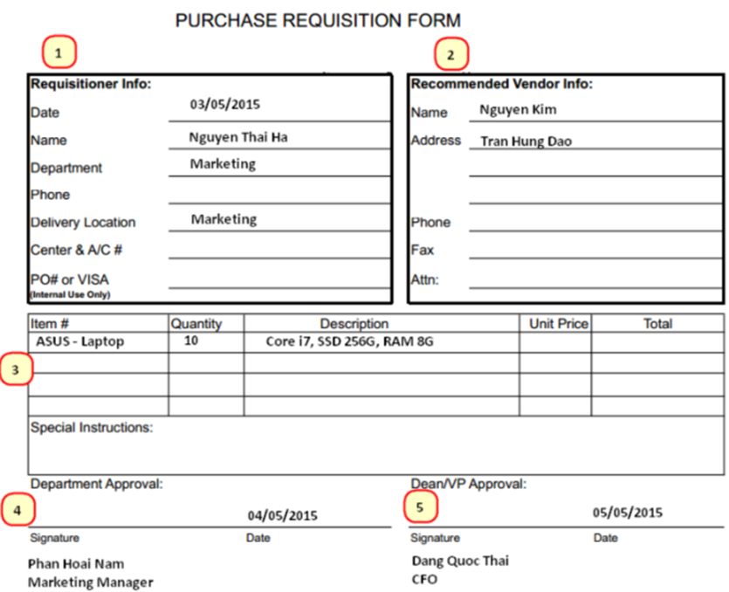
3. Purchasing process
3.1. Material requisition decision – Purchase Requisition
12
A sample Purchase Requisition form (Figure 3.9) will include the following parts

Slide 14
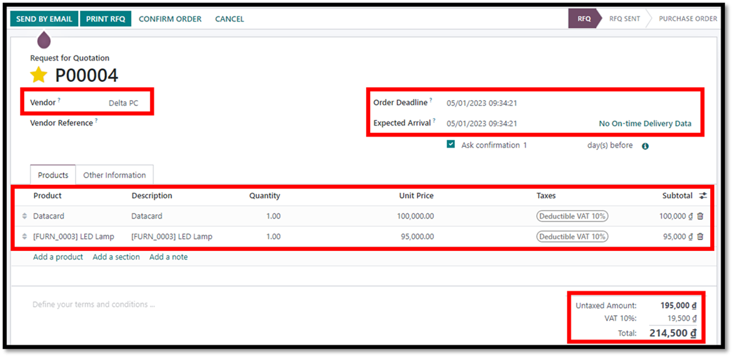
3. Purchasing process
3.2. Supply Decision – Request for Quotation
13
After the purchase request is approved and transferred to the purchasing department, depending on the value of the goods to be purchased as well as the existing supply contracts, the company decides which supplier to buy from.

Slide 15
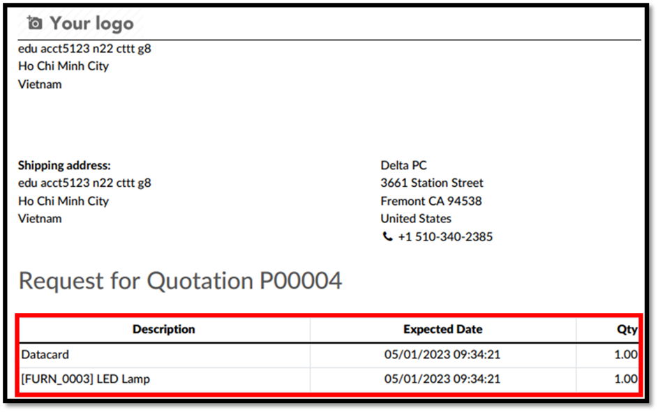
3. Purchasing process
3.2. Supply Decision – Request for Quotation
14

Slide 16
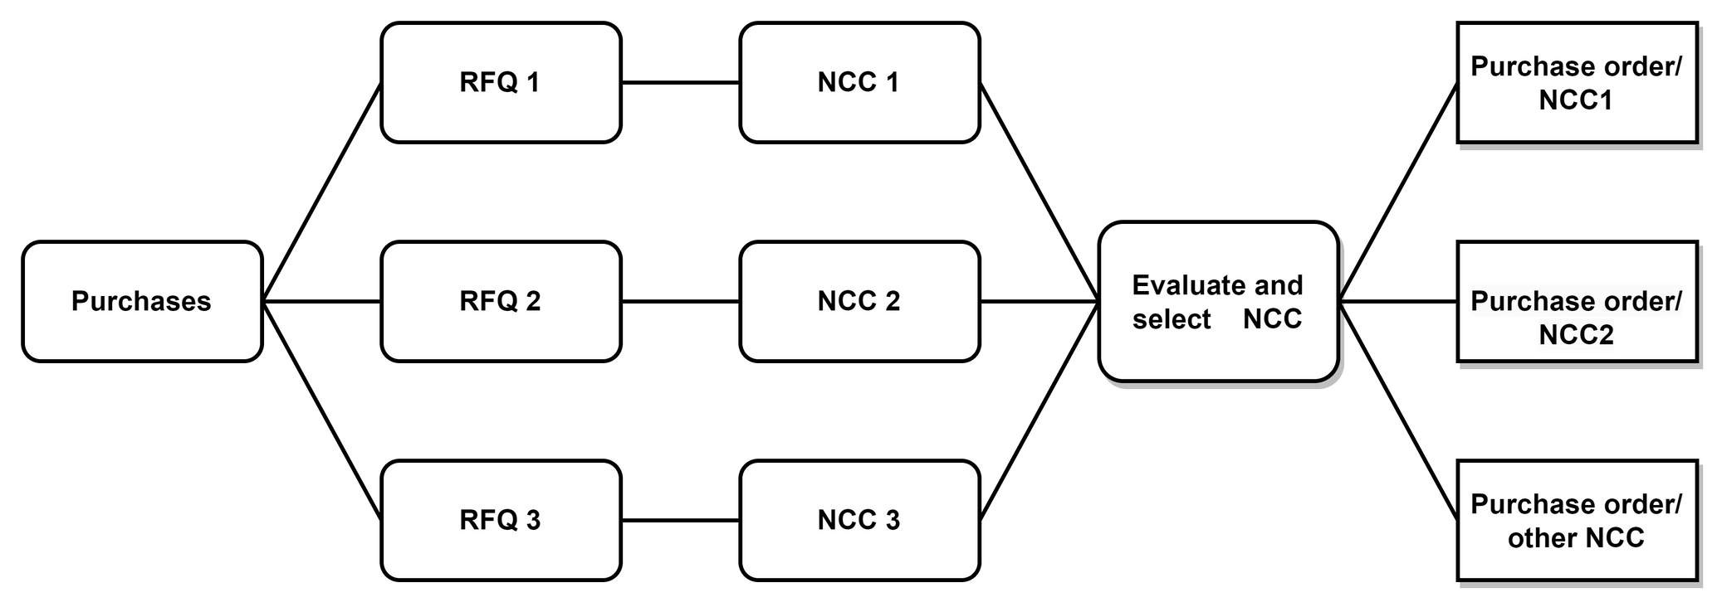
3. Purchasing process
3.3. Vendor Evaluation
15
After requesting a quote and receiving a quote from a supplier, if it is an exclusive form of supply, you can skip this step, otherwise there will be an evaluation and selection of a suitable supplier. A purchase request can have many RFQs and Quotaions corresponding to each supplier (NCC)

Slide 17
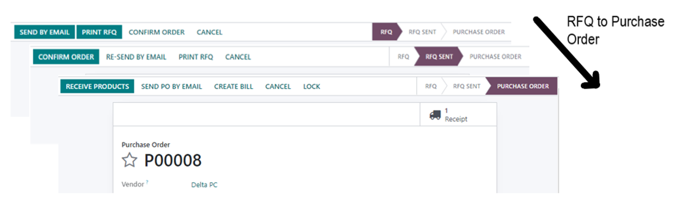
3. Purchasing process
3.4. Create purchase order & Confirm with vendor
16
Once a supplier has been selected, a purchase order is created. Whether the purchase order needs re-approval depends on the company's regulations.

Slide 18
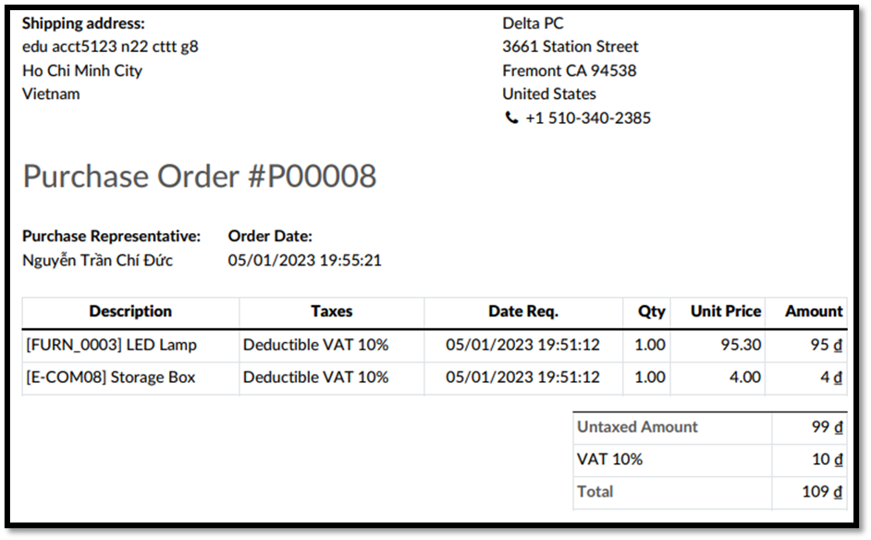
3. Purchasing process
3.4. Create purchase order & Confirm with vendor
17
The information in the Purchase Order and the RFQ is the same, only in the context of use. Depending on which step you are at, information needs to be added to complete a purchase order.

Slide 19
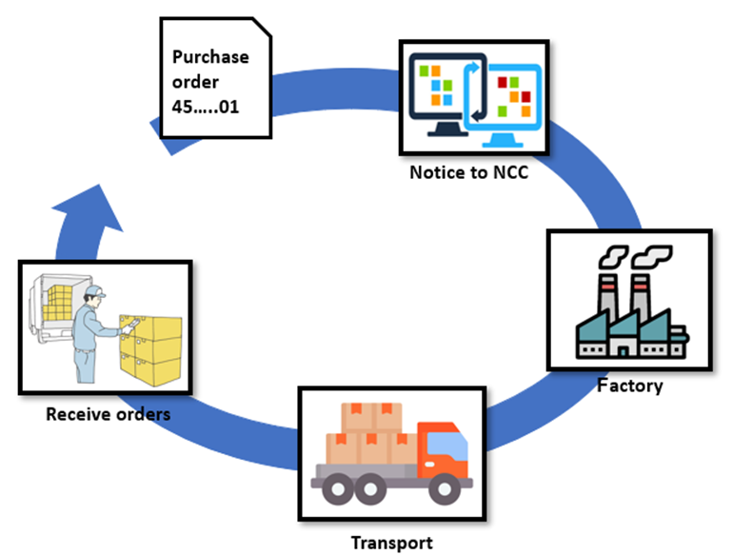
3. Purchasing process
3.5. Warehouse Receipt
18
After a purchase order is created and notified to the supplier, goods are manufactured (or purchased) from the supplier side and then shipped to the company's designated warehouse for pickup. At this point, the purchasing process is transferred to the warehouse manager.

Slide 20
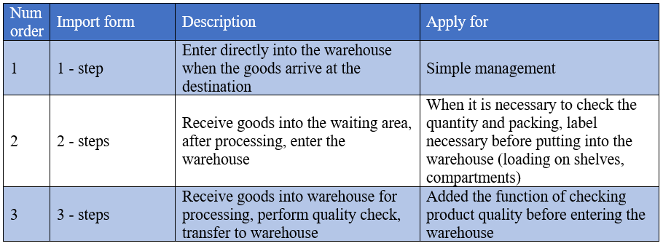
3. Purchasing process
3.5. Goods Receipt
19
Depending on the form of business and the nature of the goods, goods can be received into the warehouse in any form in Table 3.1.

Slide 21
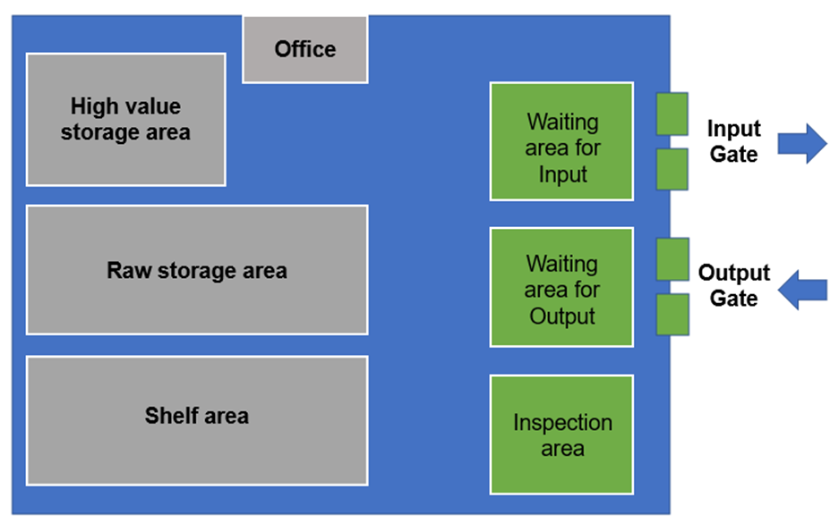
3. Purchasing process
3.5. Goods Receipt
20

Slide 22
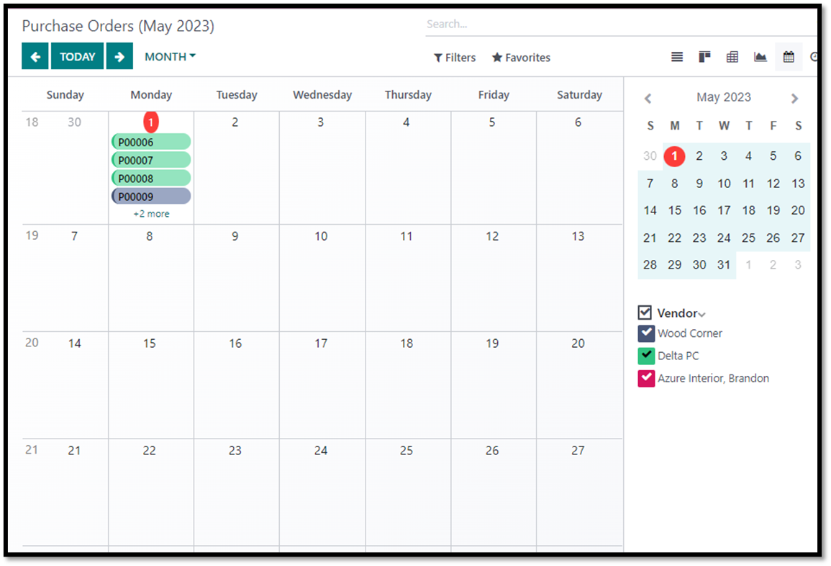
3. Purchasing process
3.5. Receipt
21
The warehouse manager will base on the delivery schedule to know which shift will receive how many goods today, from which transport, for which purchase order, from which to arrange personnel and machinery accordingly.

Slide 23
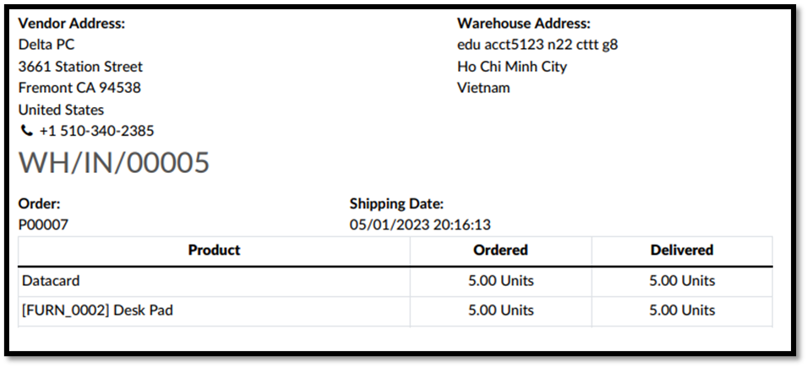
Warehouse Receipt
22

Slide 24
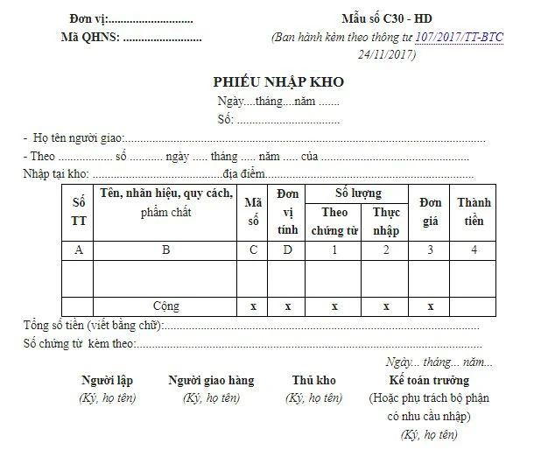
Warehouse Receipt
23

Slide 25
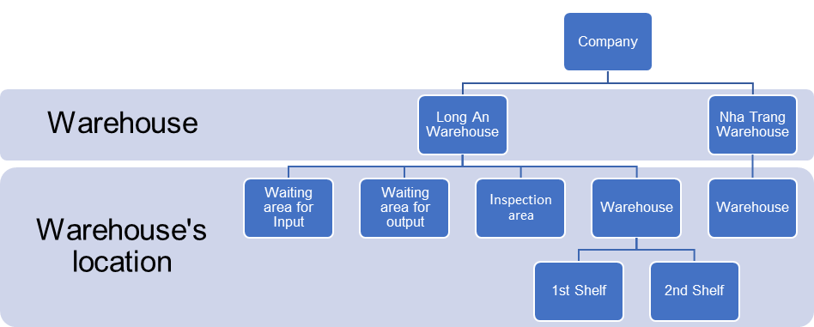
Warehouse Receipt
When delivering goods to the warehouse door, the warehouse keeper will rely on the supplier's delivery note with the company's purchase order number to check whether the company has ordered the correct goods or not. Then, depending on the method of entering the warehouse, the warehouse manager will operate on the system.
24

Slide 26
1-step Warehousing
25
Is the simplest way to receive goods and update the system. Only need 1 warehouse receipt to be able to import goods directly into the warehouse.
2-steps Warehousing
Two receipts are required, which is a warehouse receipt to bring goods to the waiting area and an Internal Transfer to pack and put on shelves.
3-steps Warehousing
Goods are brought into the warehouse waiting area with a warehouse receipt, then the warehouse manager creates an Internal Transfer to bring the goods into the waiting area for inspection. After the quality is checked and approved, the warehouse keeper will make the 2nd Internal Transfer to put the goods into the storage location.

Slide 27
Quality verification
26
The quality check step can be done at the time of receiving the goods or when moving from the waiting position to the warehouse (in the 3-step warehousing). The inspection standards are issued by the quality assurance department, usually in two forms: Quantitative and Qualitative.

Slide 28
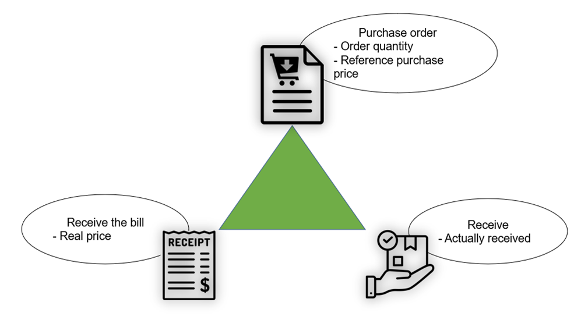
3.6. Receive and validate supplier invoices
27

Slide 29

3.3.7. Payment to suppliers
28

Slide 30
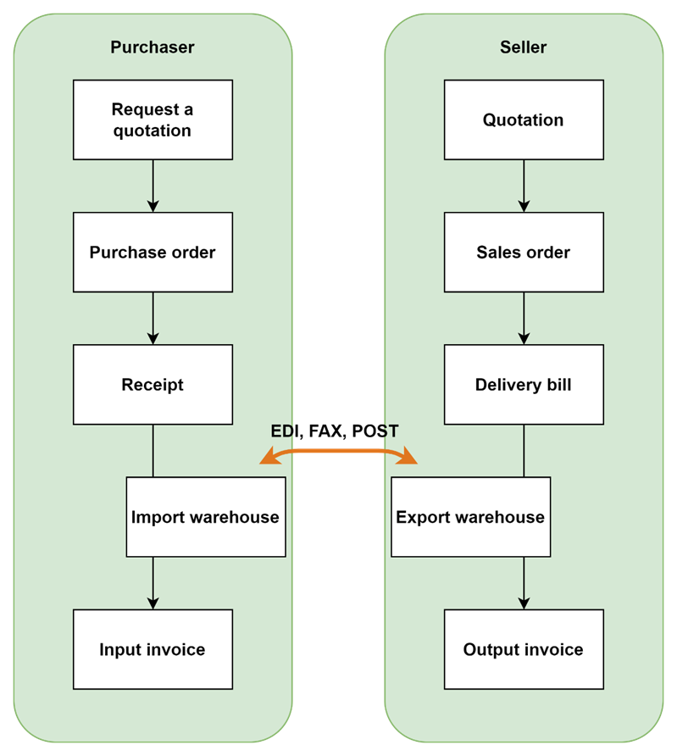
4. Correlation between Purchasing and Selling
29

Slide 31
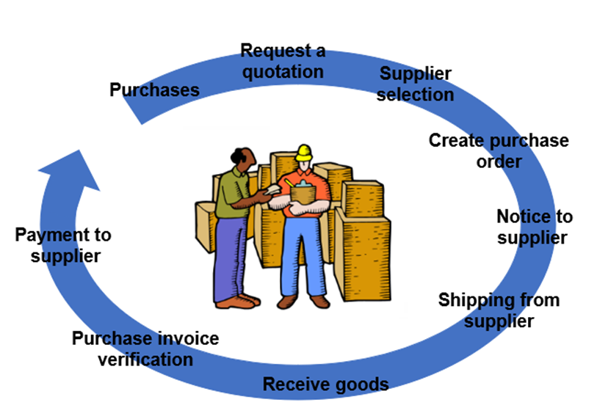
SUMMARY
30

Slide 32



Do you have any question?
Please send us! Hope you learned something new.

Slide 33






THANK YOU
FOR
LISTENING

